Slide 1
Wild about animals!

Slide 2
Have a good look at a cookery book.
Let’s go to the zoo after school. It’s cool.

Slide 3
Put the missing words
A: What are you doing?
В: I’m reading a book about....
A: Really? Do you like ... ?
B: Oh yes! I think they’re ...!
A: Look at the picture - the ...!
B: Of course!..., you know.

Slide 4
Check yourself
What are you doing?
I’m reading a book about giraffes.
Really? Do you like giraffes?
Oh yes! I think they ’re funny!
Look at the picture — the giraffe is eating from a tree!
Of course! Giraffes are very tall, you know.

Slide 5
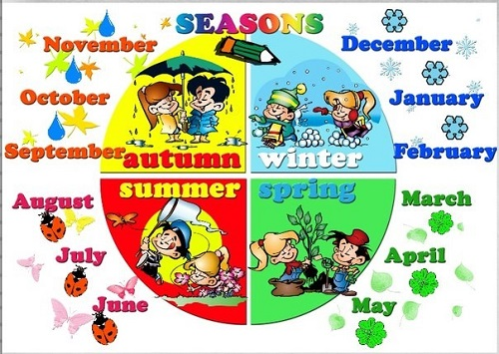

Slide 6
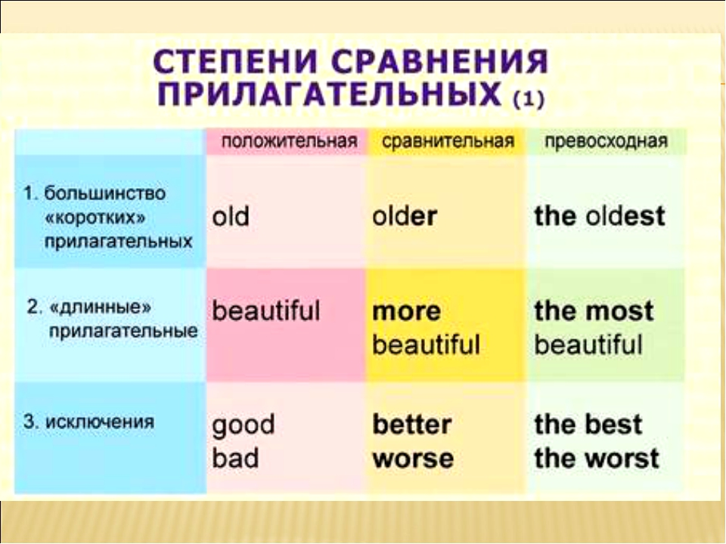

Slide 7
The pencil is longer than the pen.
The pen is shorter than the pencil.

Slide 8
Рефлексия
Can you say when your birthday is?
Can you compare things, animals or people?
What do you Uke best in our lesson?

Slide 9

Goodbye!

